Slide 1
INCREMENTAL MODEL
TEAM MEMBERS:
1. ASTHA JAIN
2. ARYAN SHARMA
3. ADITI RAJARSHI
4. ABHISHEK KADAM
5. PRASHANTH A BHOSALE

Slide 2
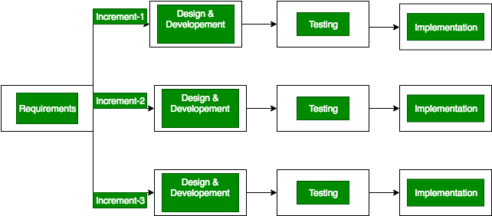
INTRODUCTION:
Incremental Model is a process of software development where requirements are broken down into multiple standalone modules of software development cycle.
The system is put into production when the first increment is delivered. The first increment is often a core product where the basic requirements are addressed, and supplementary features are added in the next increments.

Slide 3
Features
Characteristics:
System development is broken down into many mini development projects
Partial systems are successively built to produce a final total system
Highest priority requirement is tackled first
Once the requirement is developed, requirement for that increment are frozen
When to use:
Requirements of the system are clearly understood
When demand for an early release of a product arises
When software engineering team are not very well skilled or trained
When high-risk features and goals are involved
Such methodology is more in use for web application and product based companies

Slide 4
PHASES:
Requirement analysis: In the first phase of the incremental model, the product analysis experts identifies the requirements. And the system functional requirements are understood by the requirement analysis team. To develop the software under the incremental model, this phase performs a crucial role.
Design & Development: In this phase of the Incremental model of SDLC, the design of the system functionality and the development method are finished with success. When software develops new practicality, the incremental model uses style and development phase.
Testing: In the incremental model, the testing phase checks the performance of each existing function as well as additional functionality. In the testing phase, the various methods are used to test the behavior of each task.
Implementation: Implementation phase enables the coding phase of the development system. It involves the final coding that design in the designing and development phase and tests the functionality in the testing phase. After completion of this phase, the number of the product working is enhanced and upgraded up to the final system product

Slide 5
ADVANTAGES
It is easier to test on smaller modules.
Requirements of the system are clearly understood
Easier to find faults as testing is done after each iteration.
Customer is also involved after each build.

Slide 6
DISADVANTAGES
Requires a good planning designing.
System architecture can cause problems because not all requirements for the entire software lifecycle are combined.
Each iteration phase is rigid and does not overlap each other.
Rectifying a problem in one unit requires correction in all the units and which consumes a lot of time.

Slide 7

EXAMPLE:
In the diagram above when we work incrementally we are adding piece by piece but expect that each piece is fully finished. Thus keep on adding the pieces until it’s complete.
As in the image above a person has (can be considered) thought of the application. Then he started building it and in the first iteration the first module of the application or product is totally ready and can be demoed to the customers.
similarly in the second iteration the other module is ready and integrated with the first module. Similarly, in the third iteration the whole product is ready and integrated. Hence, the product got ready step by step.

Slide 8
THANK
YOU

